Slide 1

GOLD TRAINING PROGRAM
Notes:
1

Slide 2
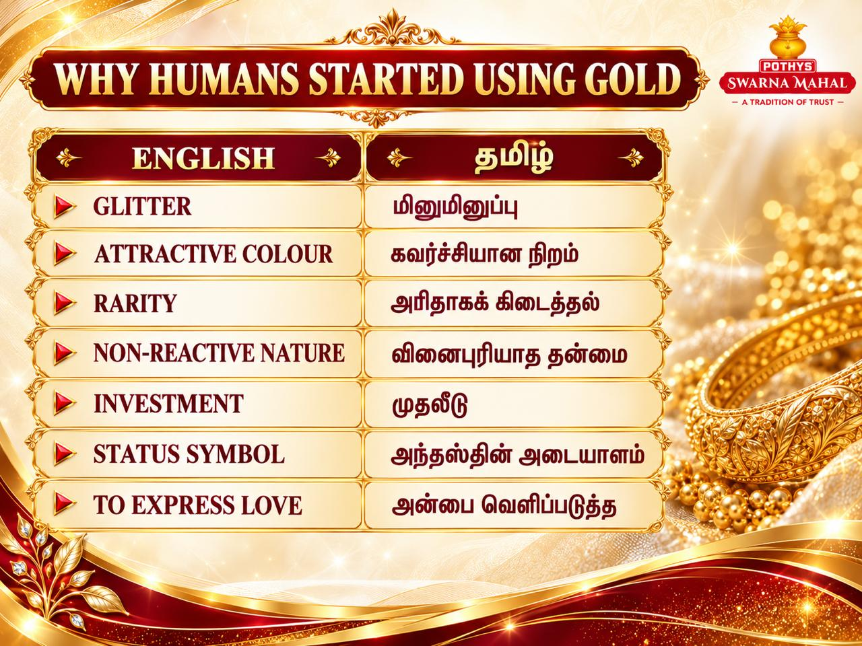
Notes:
2

Slide 3
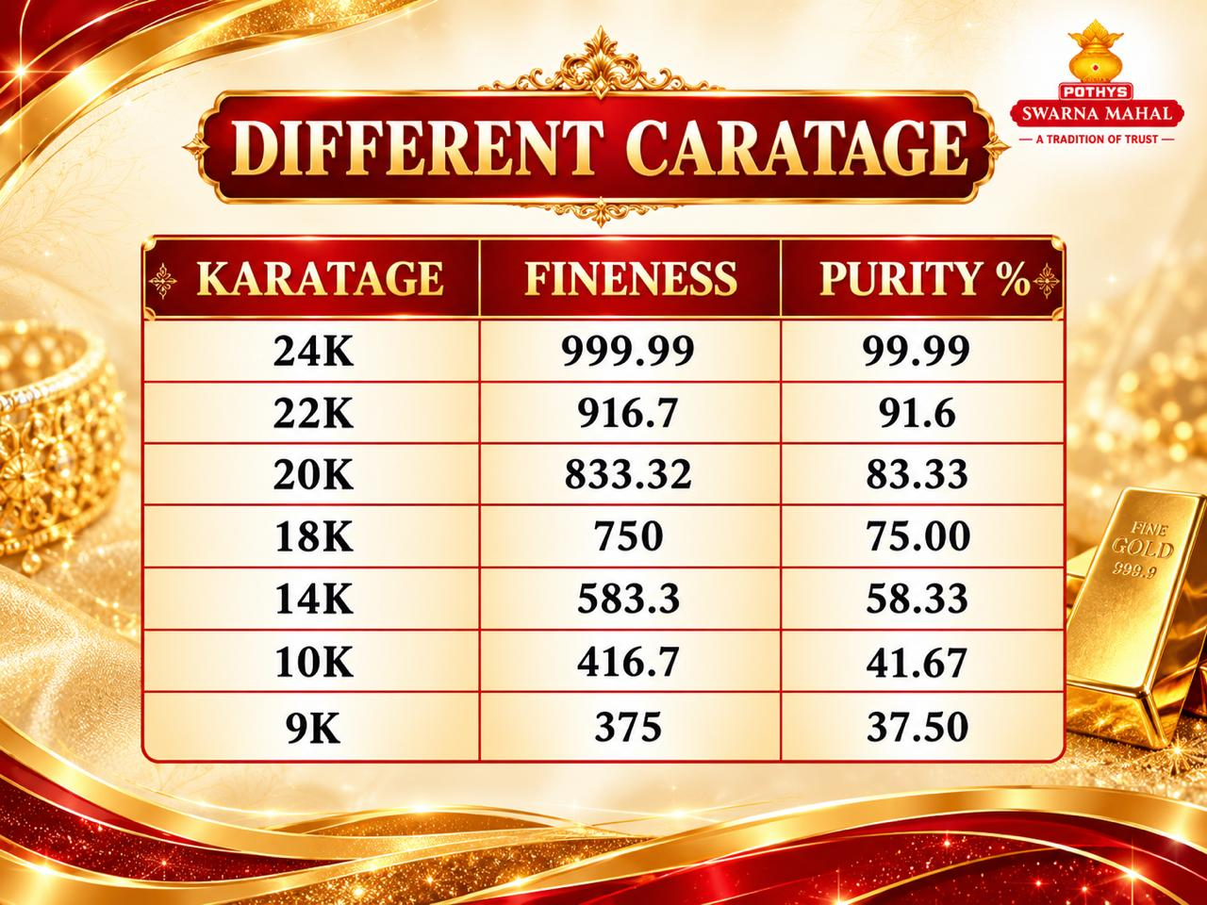
Notes:
3

Slide 4
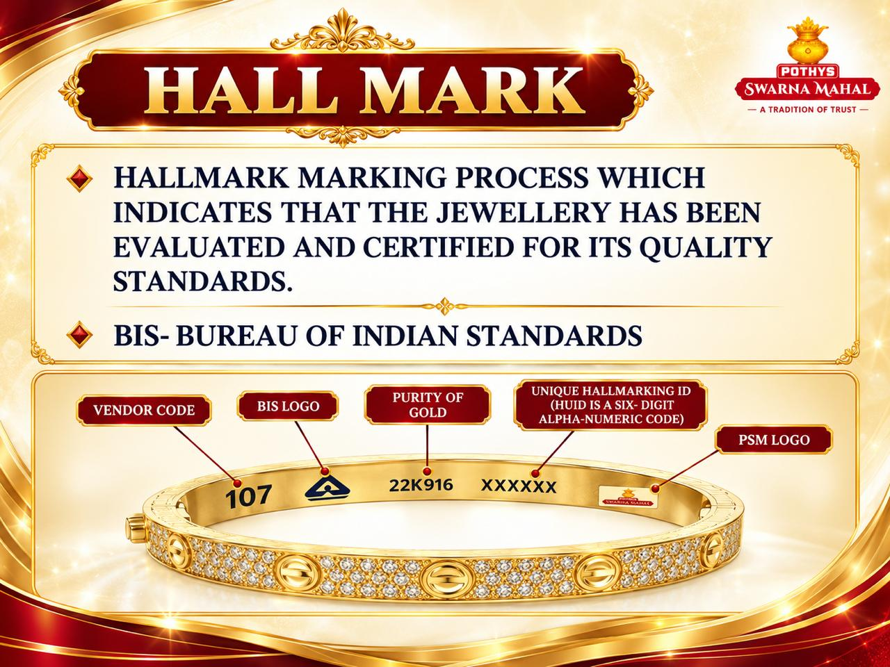
Notes:
4

Slide 5

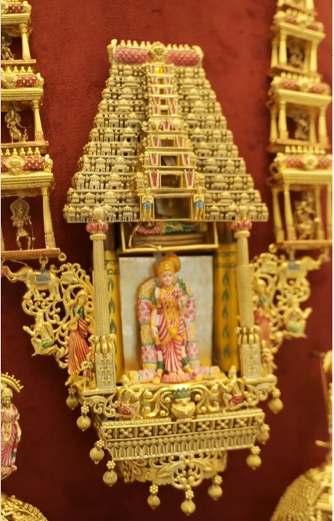

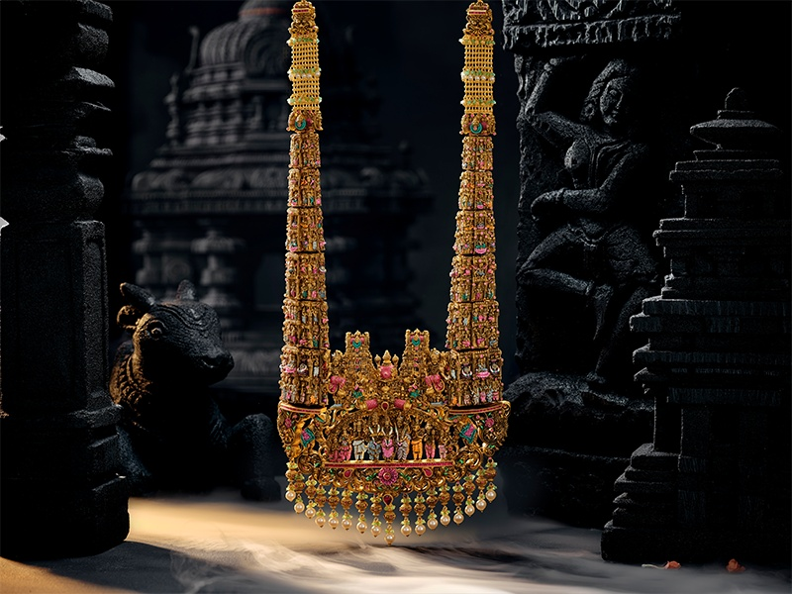
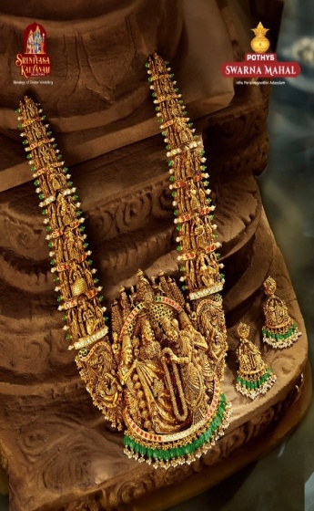
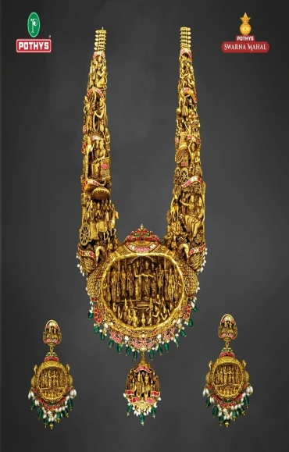
OUR USP - Unique Wedding Collections
2022
Goddess Andal
2023
Konark Sun Temple
2024
Meenakshi Thirukalyanam
2025
Srinivasa Kalyanam
2025
Ramayana Saga

Slide 6

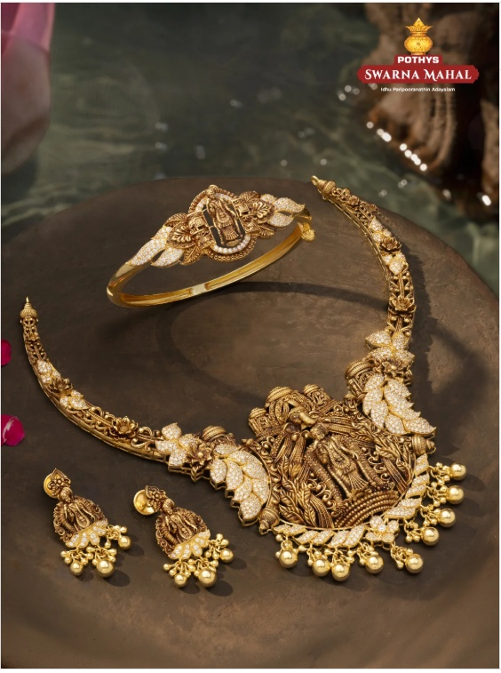
OUR USP - Unique Wedding Collections
2026 –
Meenakshi Collections – Lightweight Jewellery,
Timeless Beauty

Slide 7
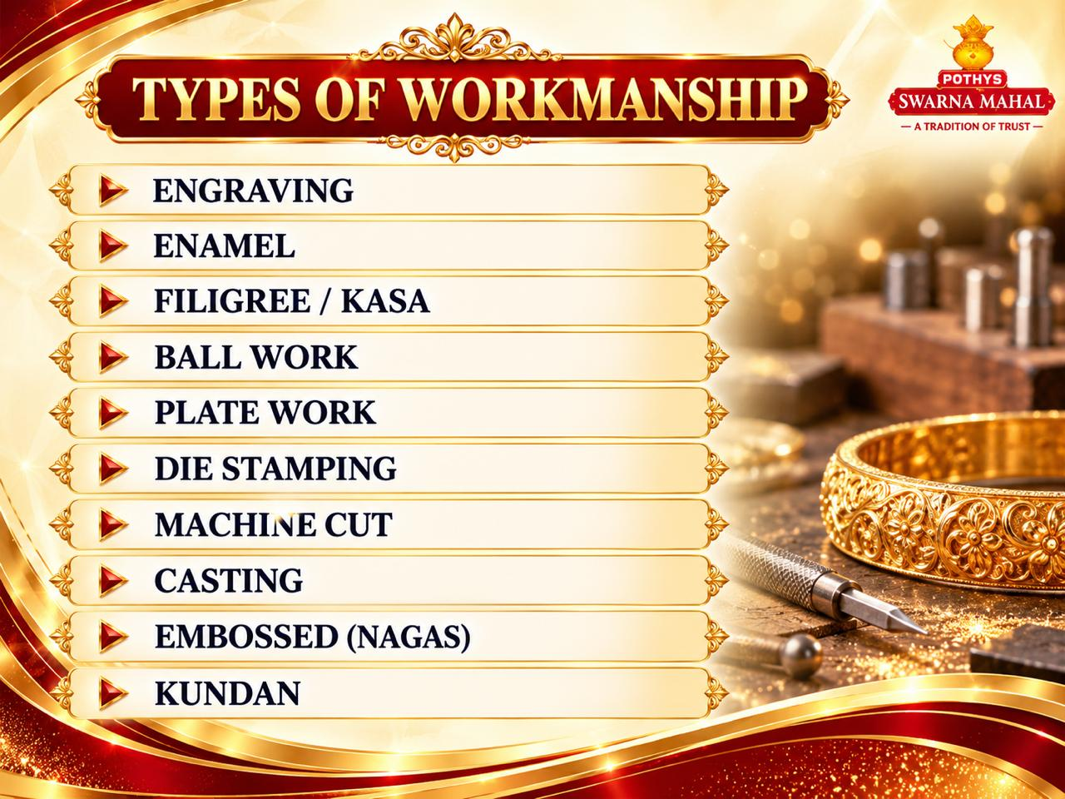
Notes:
7

Slide 8
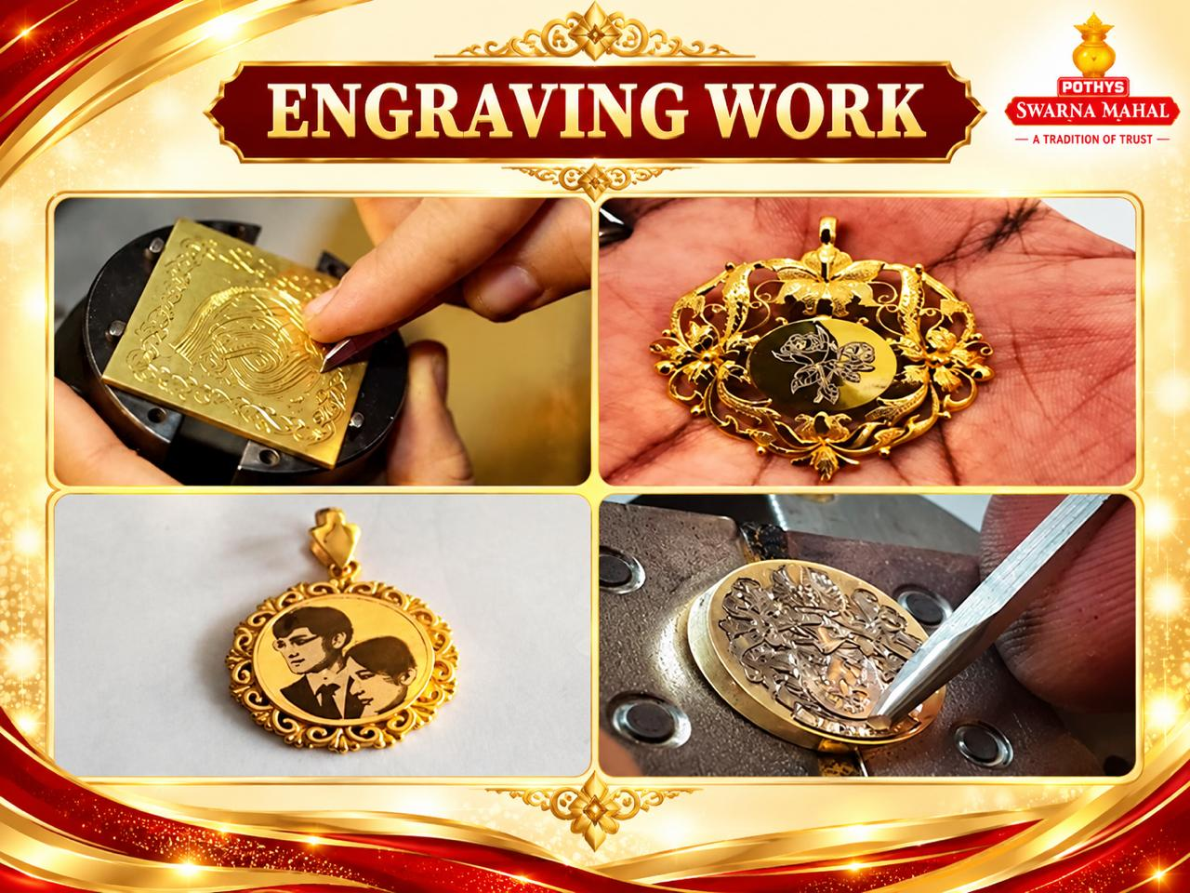
Notes:
8

Slide 9
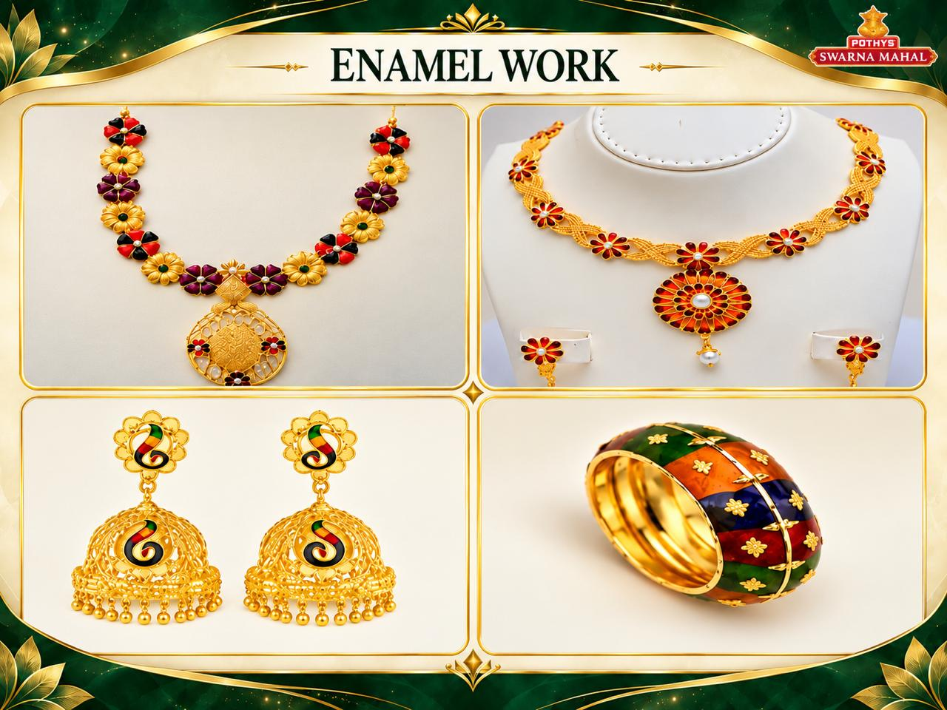
Notes:
9

Slide 10
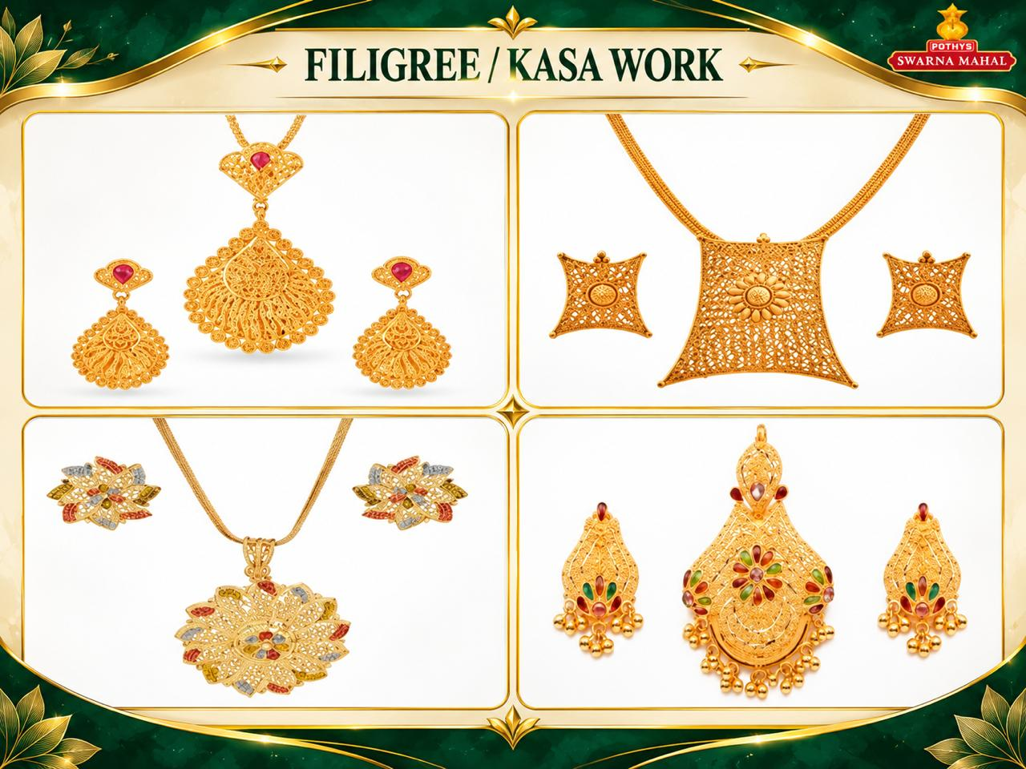
Notes:
10

Slide 11

Notes:
11

Slide 12
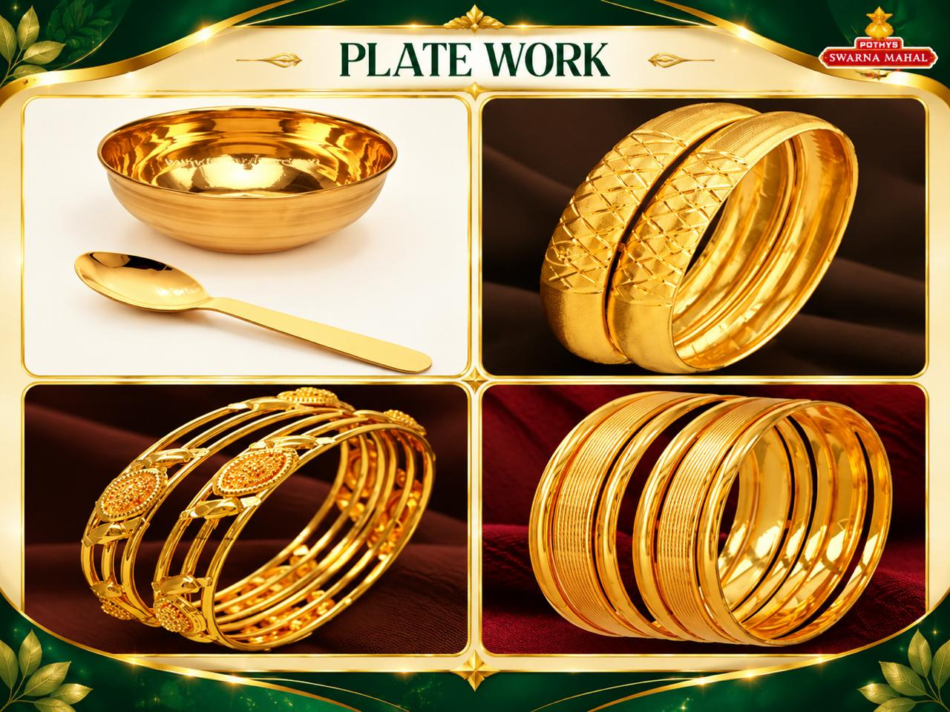
Notes:
12

Slide 13
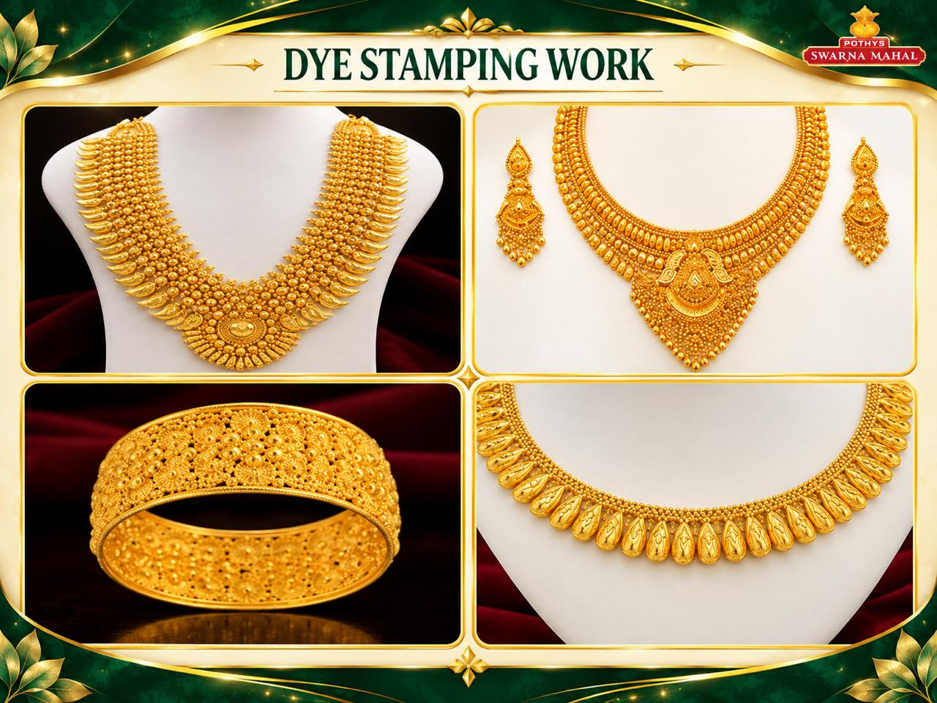
Notes:
13

Slide 14

Notes:
14

Slide 15
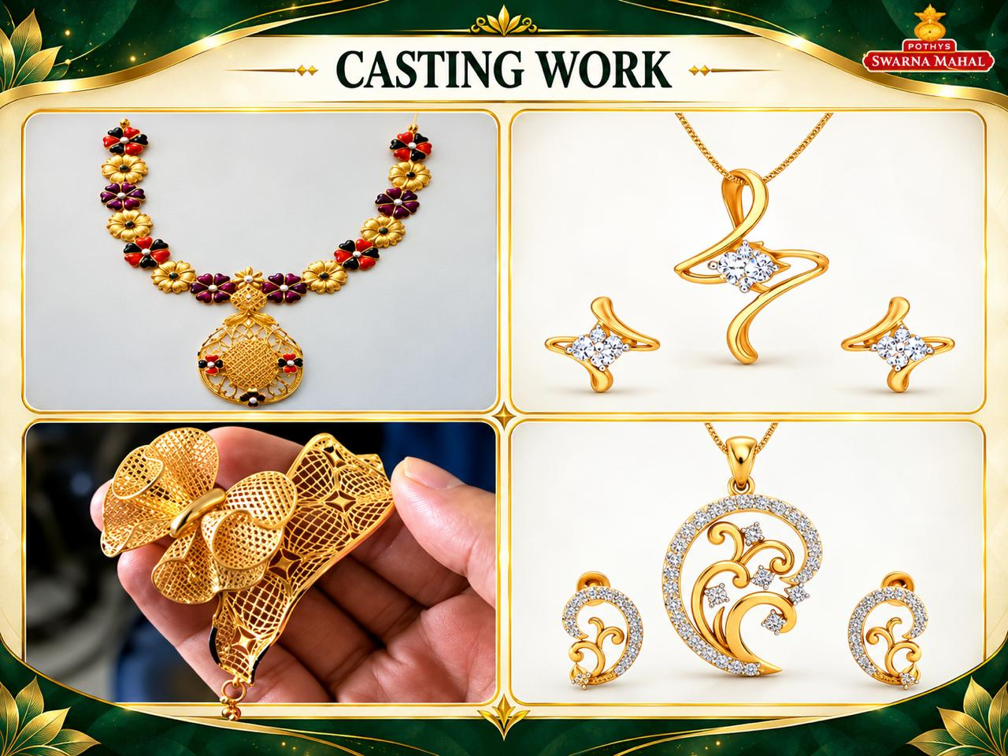
Notes:
15

Slide 16
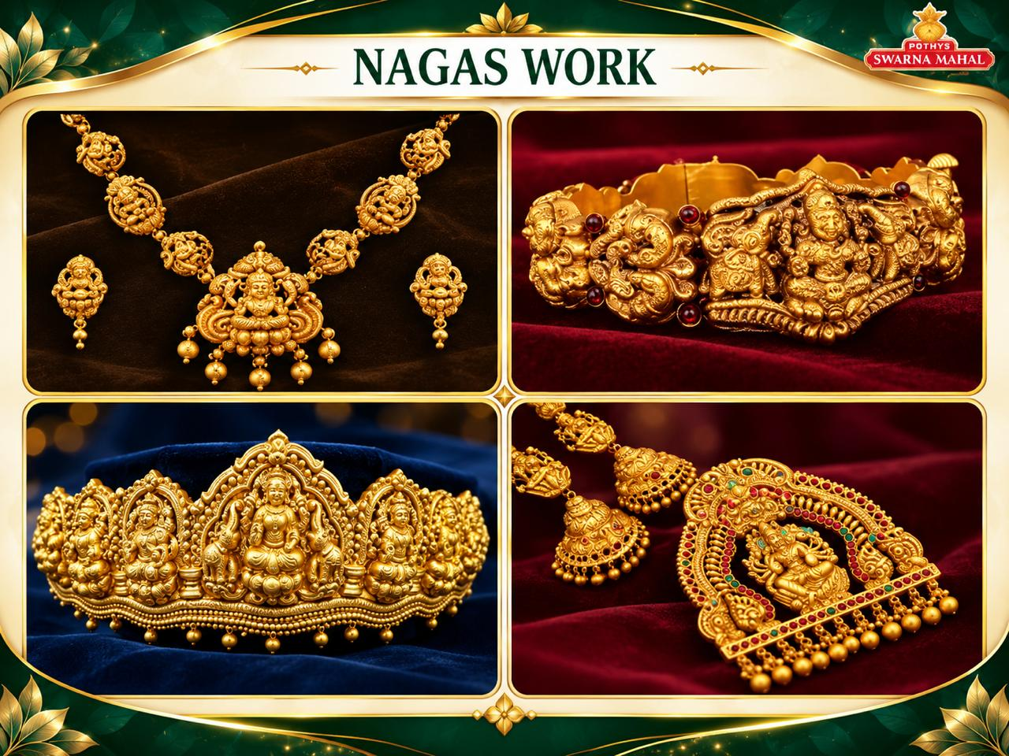
Notes:
16

Slide 17
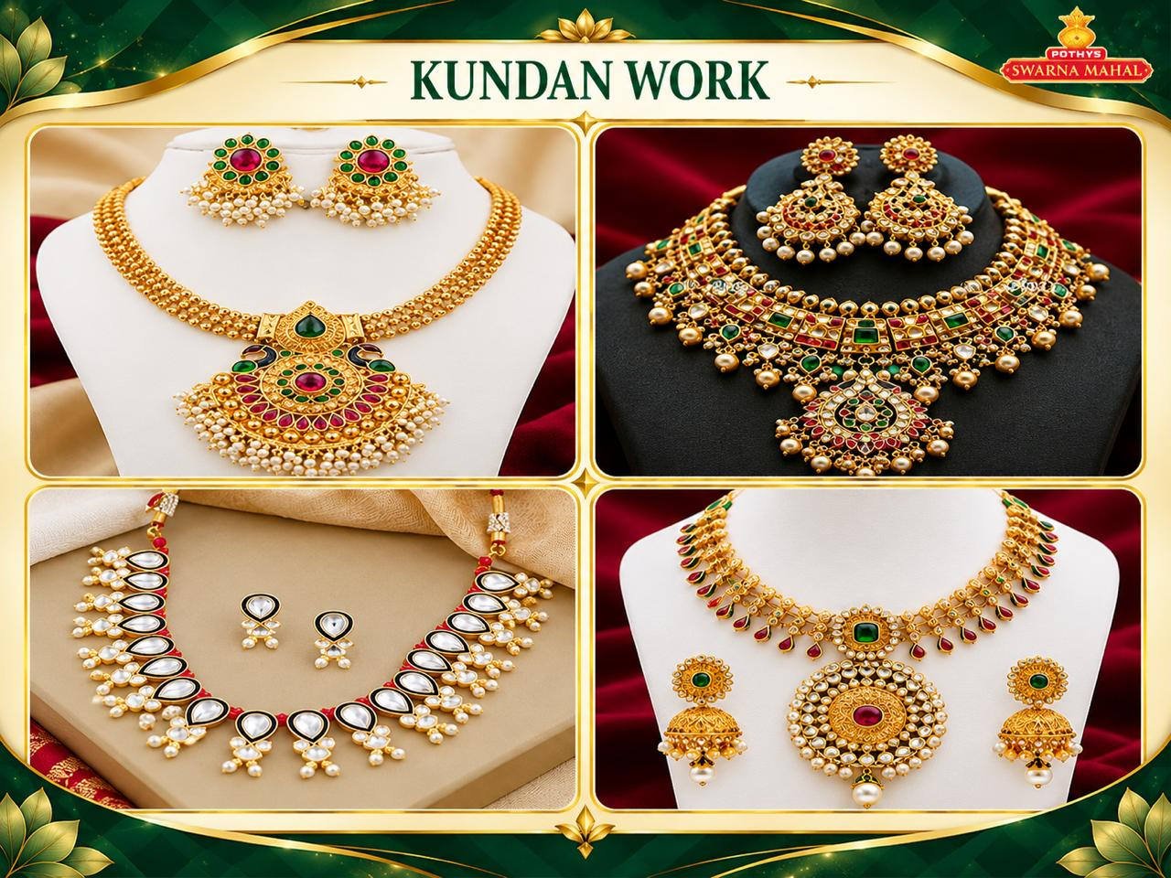
Notes:
17

Slide 18
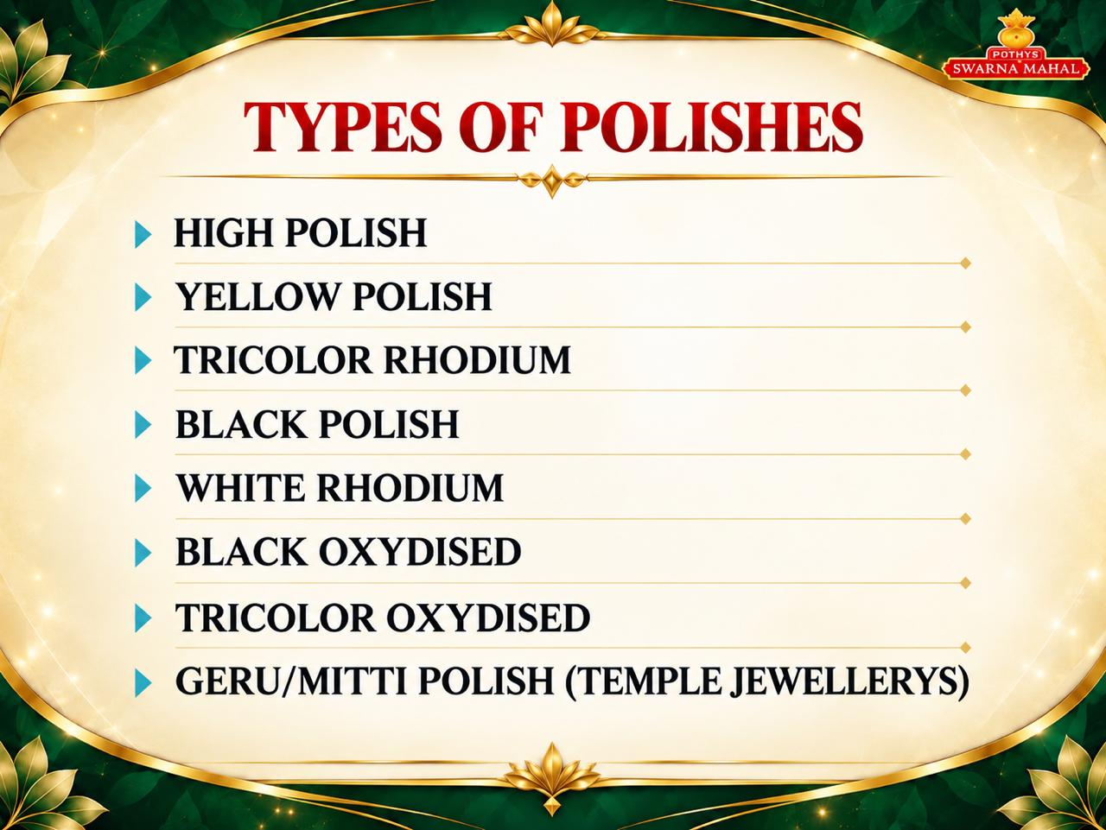
Notes:
18

Slide 19
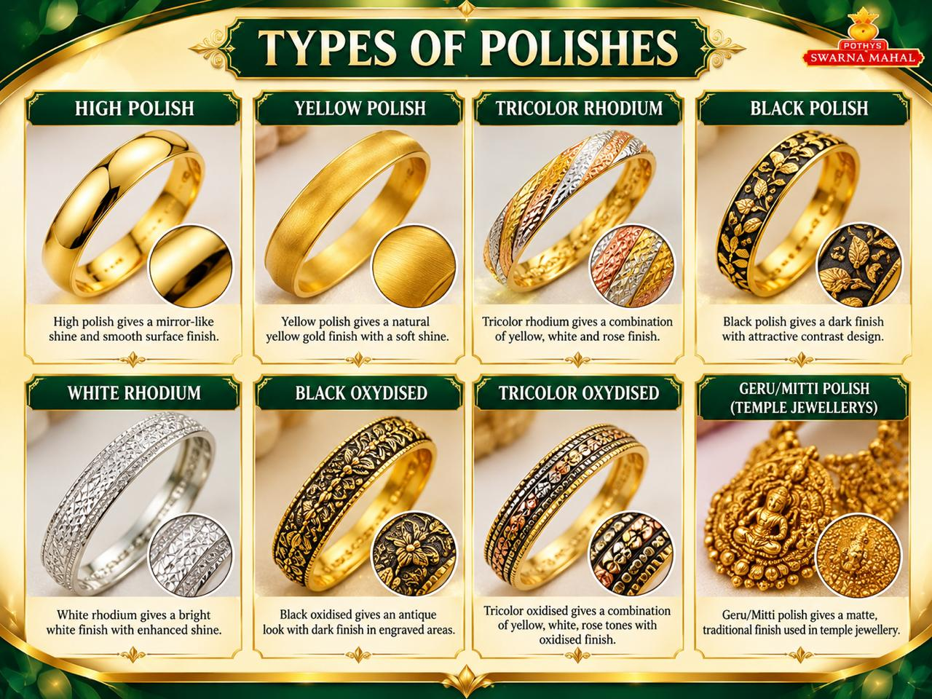
Notes:
19

Slide 20
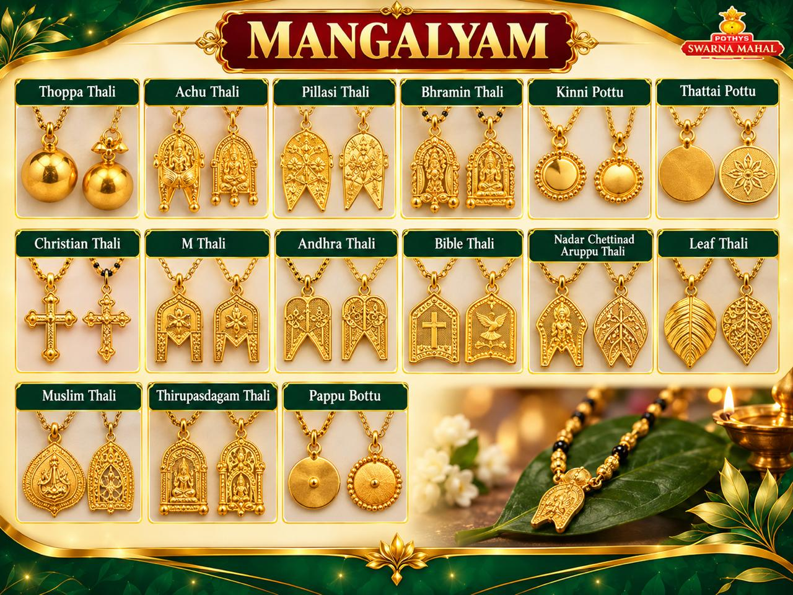
Notes:
20

Slide 21
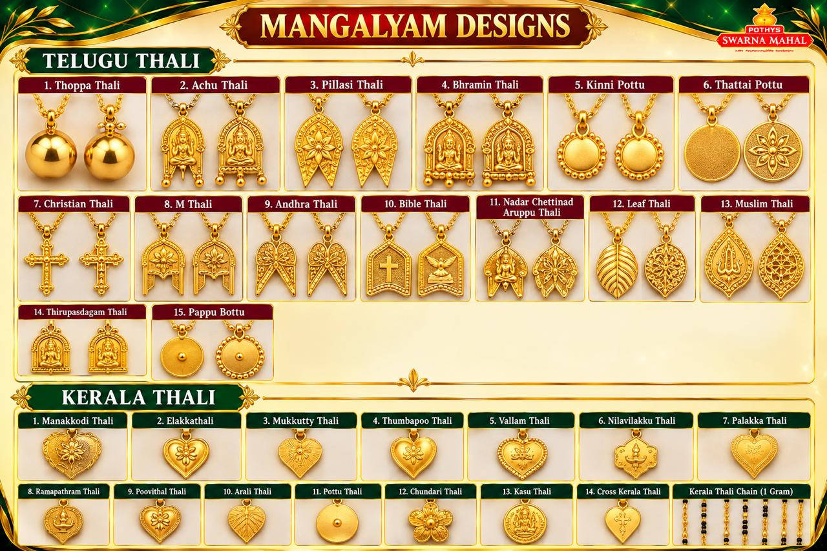
Notes:
21

Slide 22
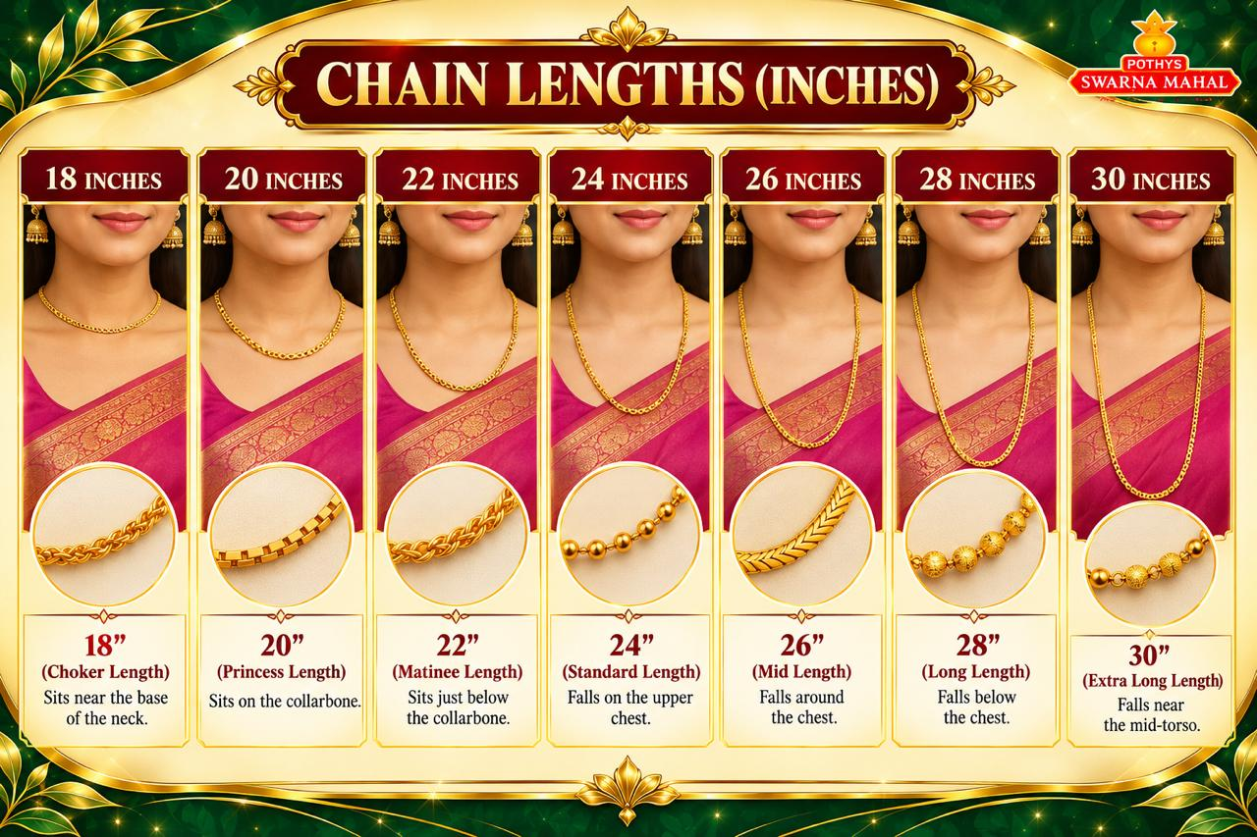
Notes:
22

Slide 23
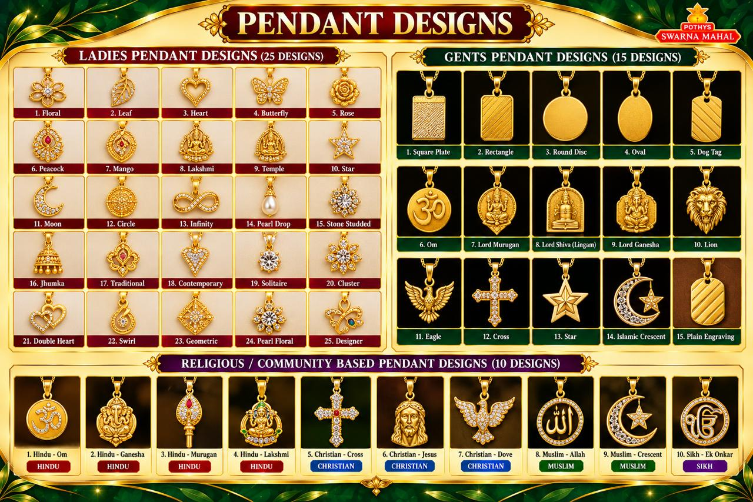

Slide 24
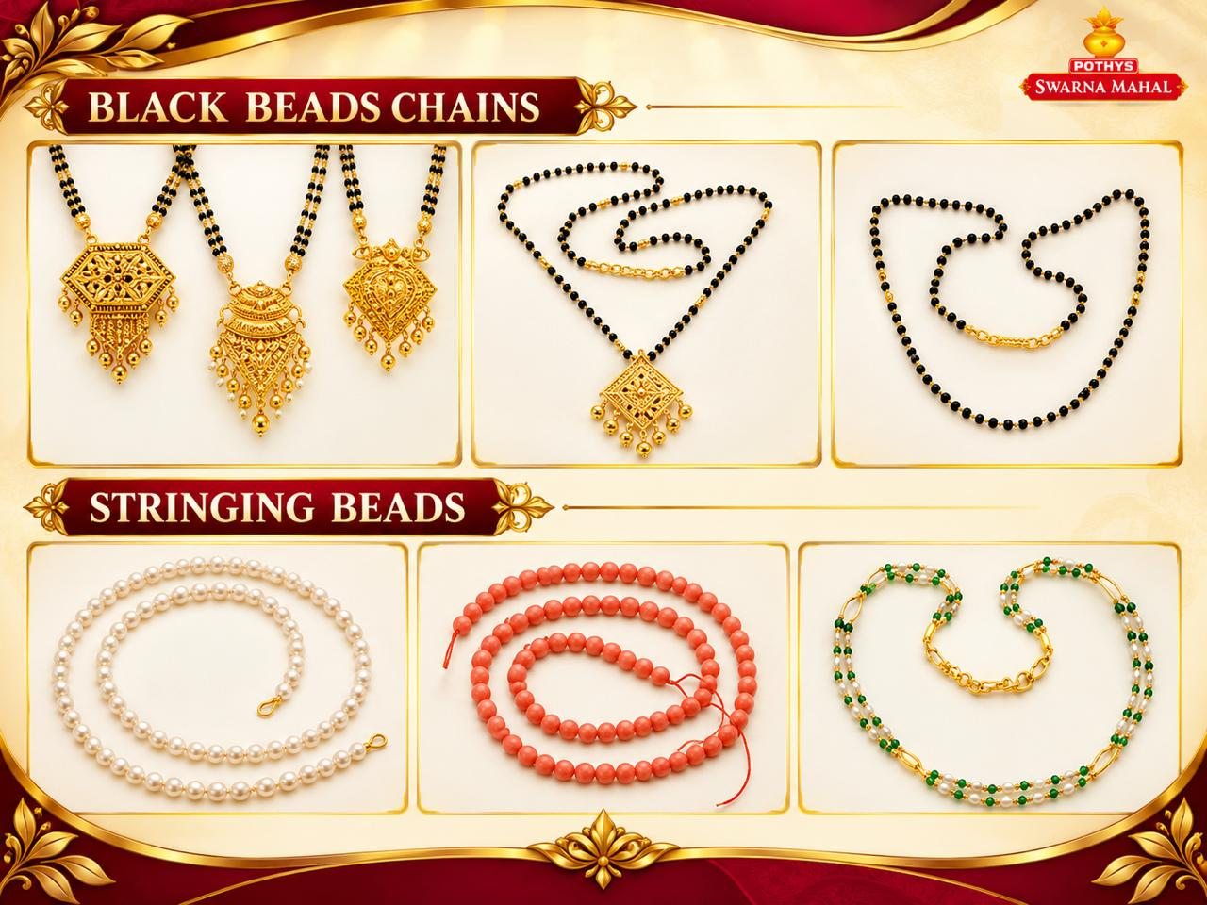
Notes:
24

Slide 25
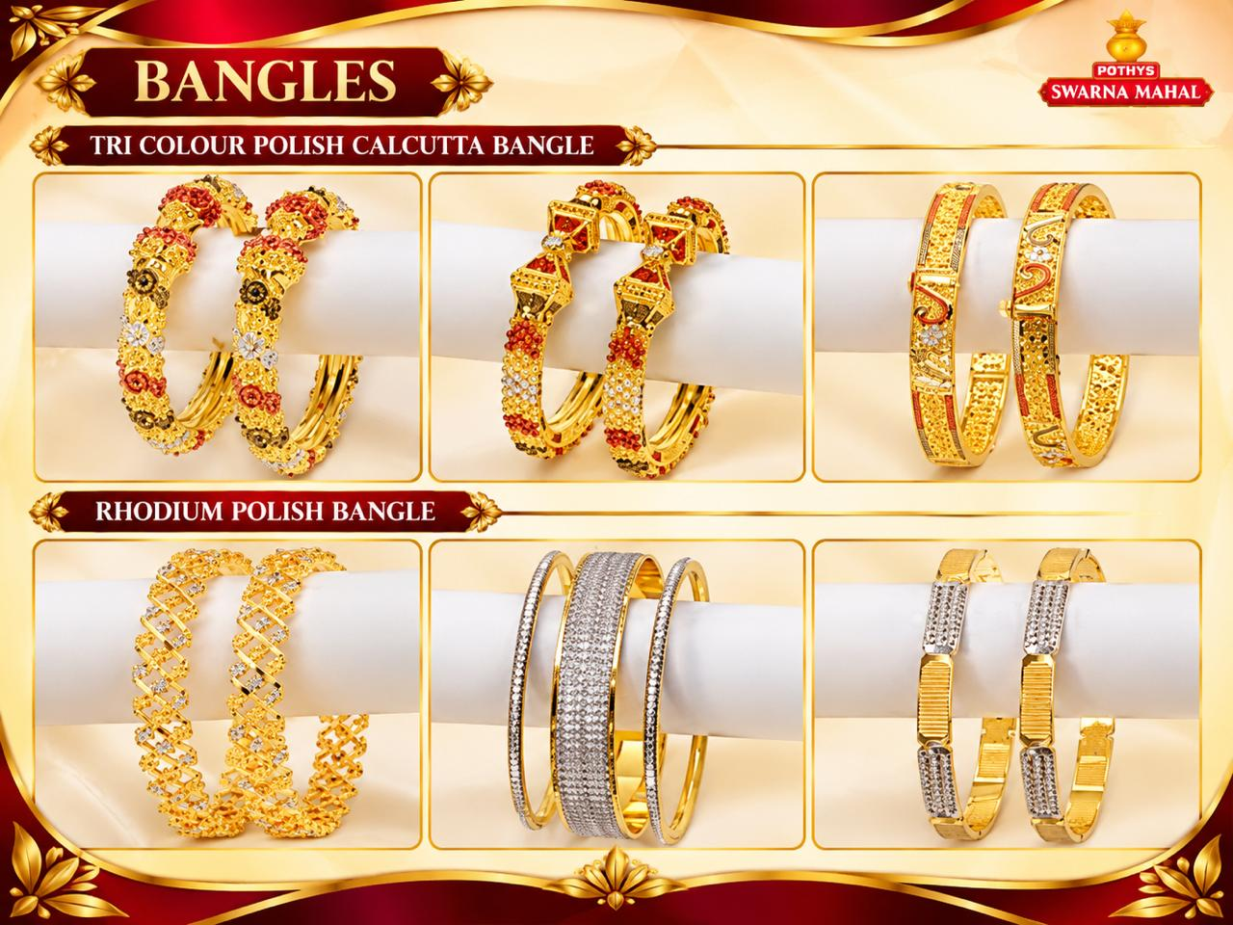
Notes:
25

Slide 26

Notes:
26

Slide 27
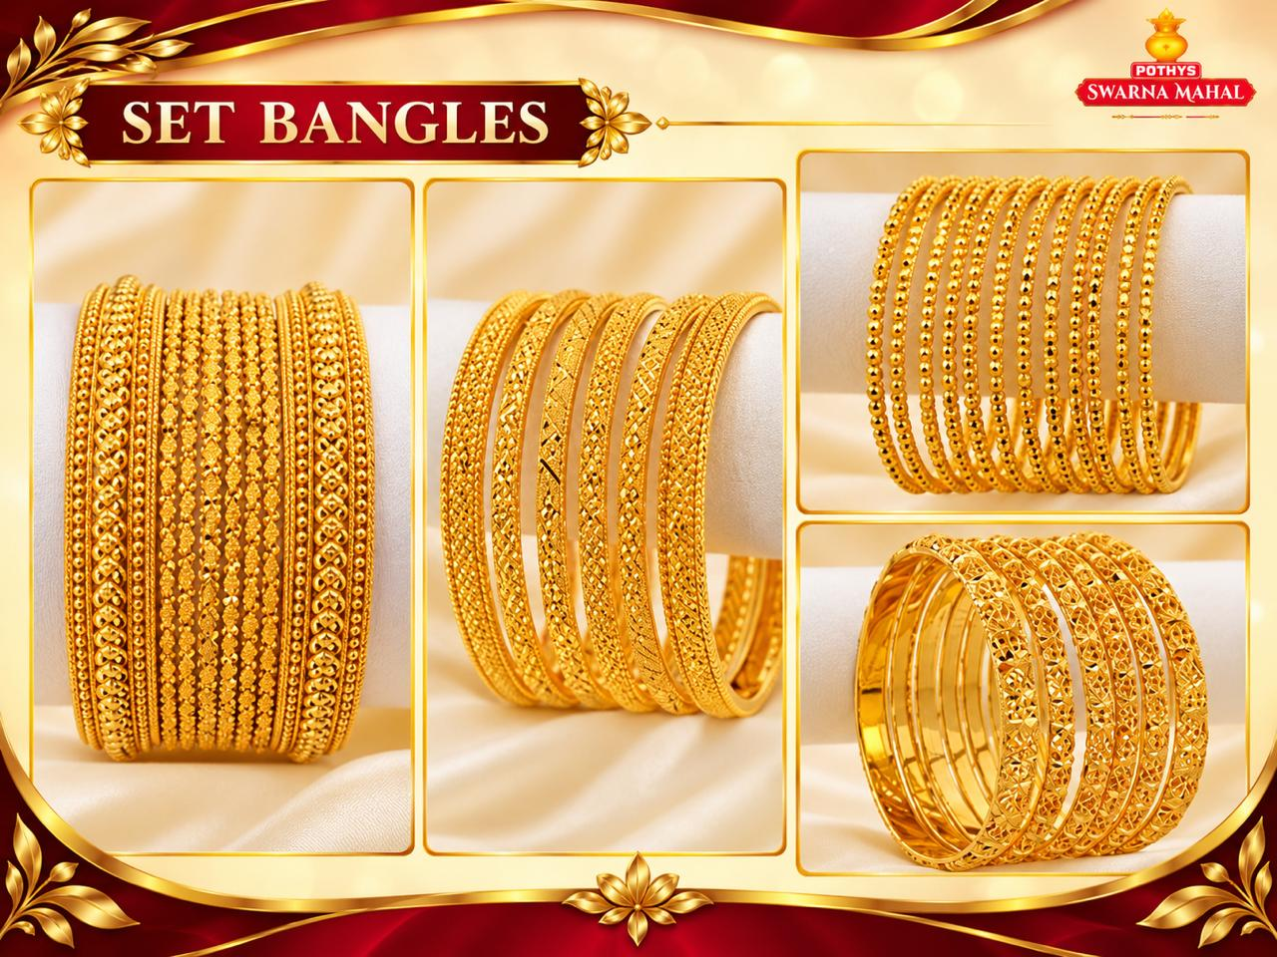
Notes:
27

Slide 28
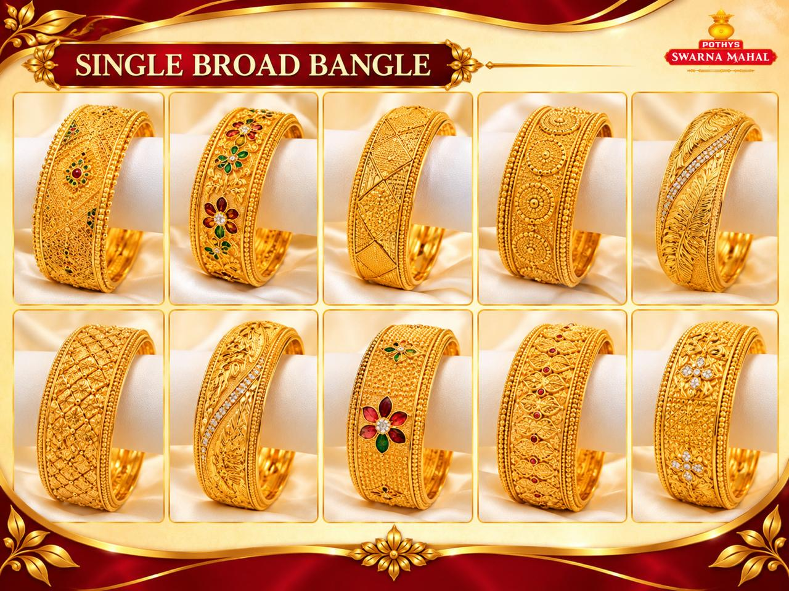
Notes:
28

Slide 29
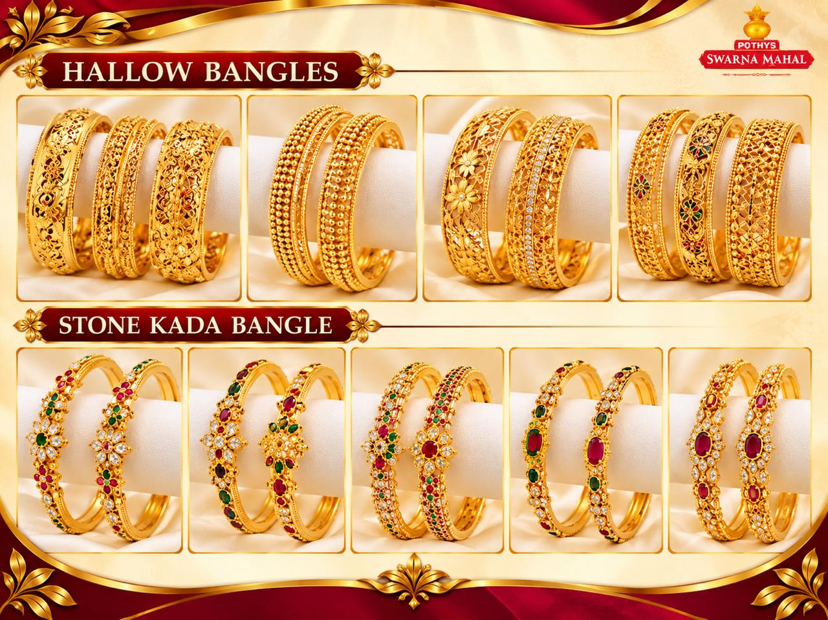
Notes:
29

Slide 30
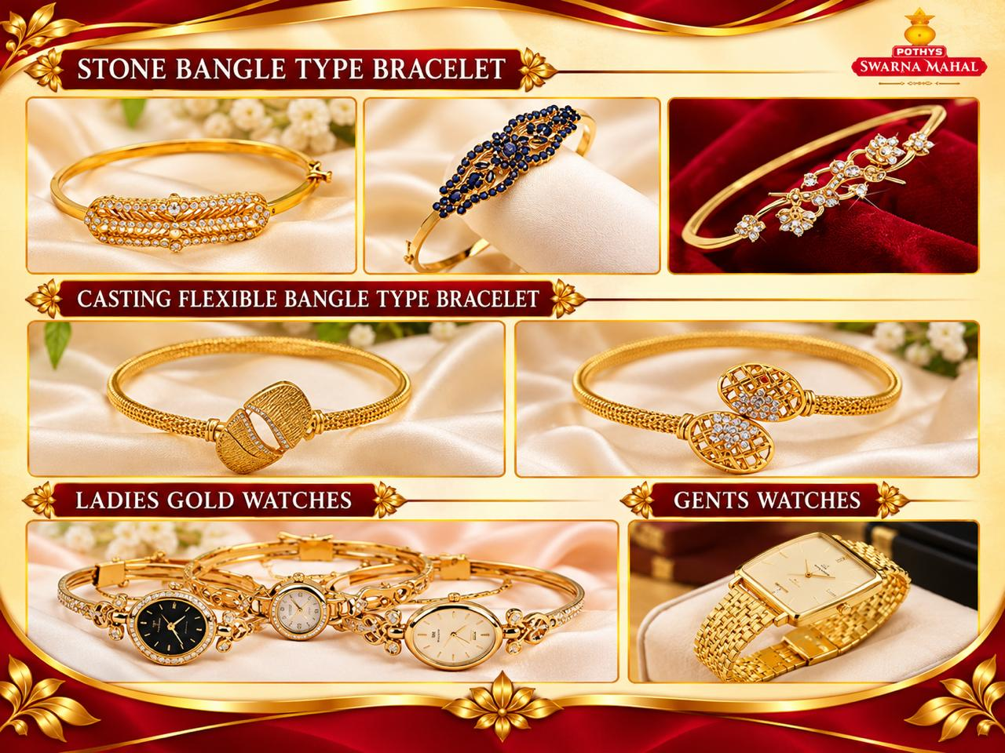
Notes:
30

Slide 31
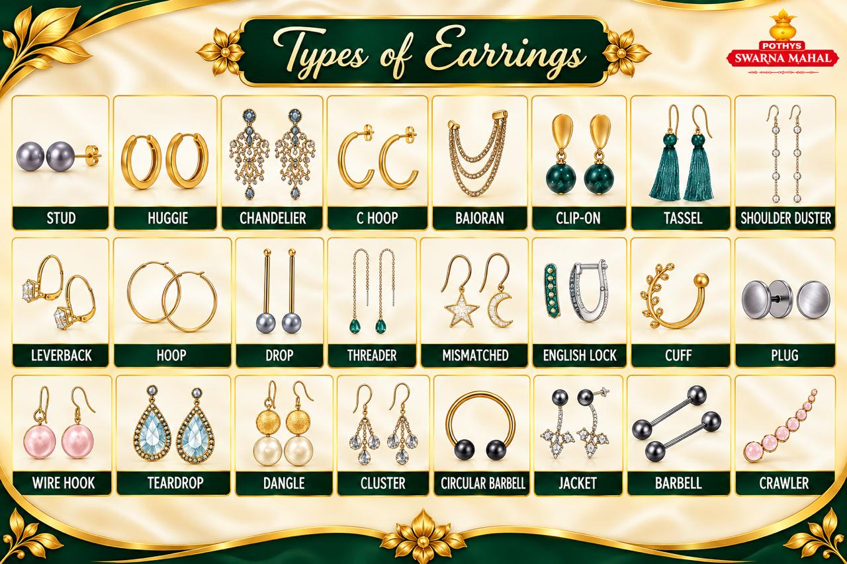

Slide 32
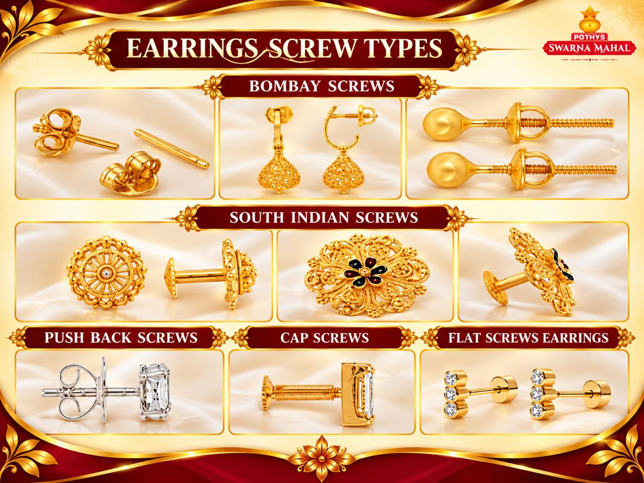

Slide 33
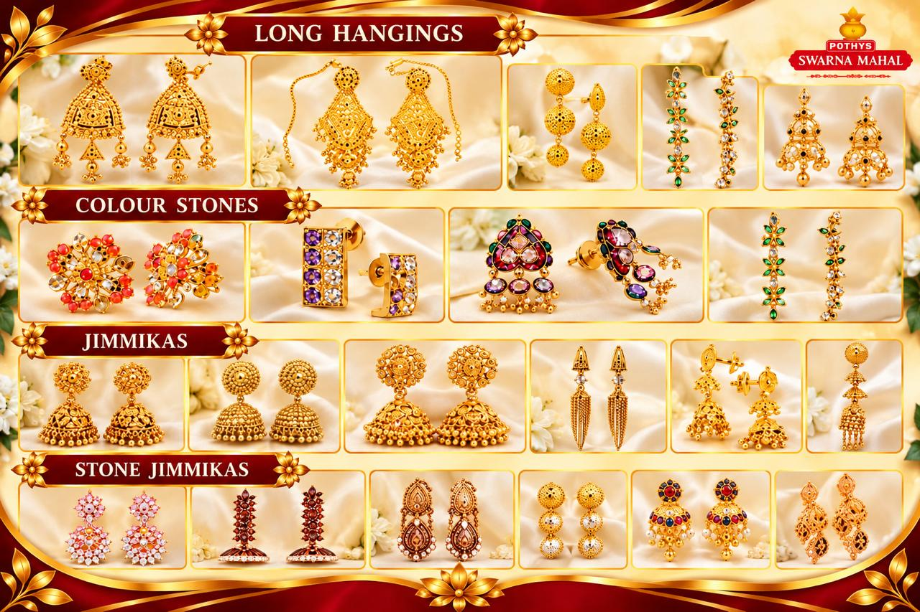

Slide 34


Slide 35
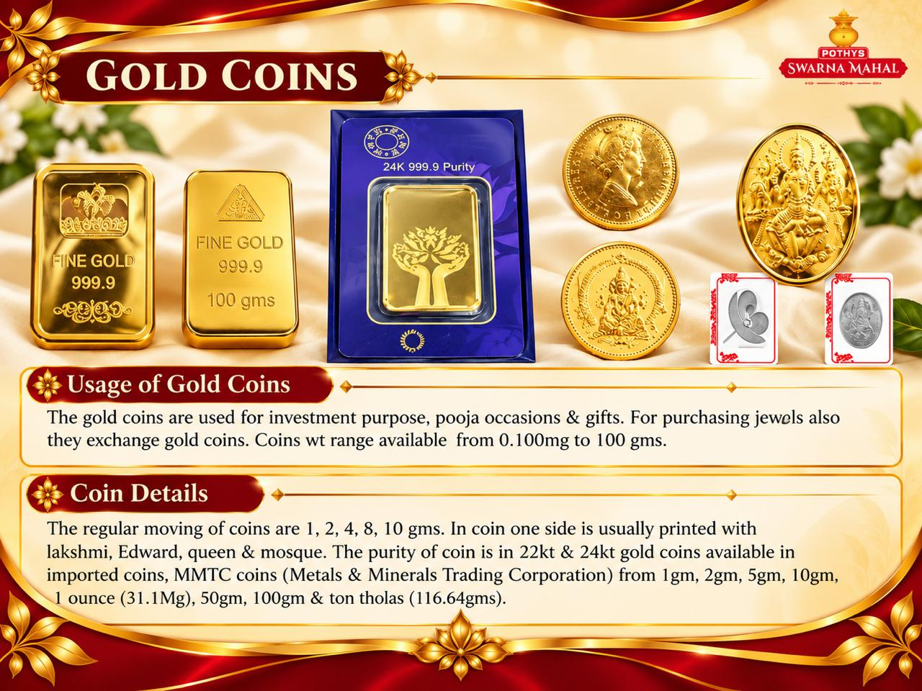
Notes:
35

Slide 36
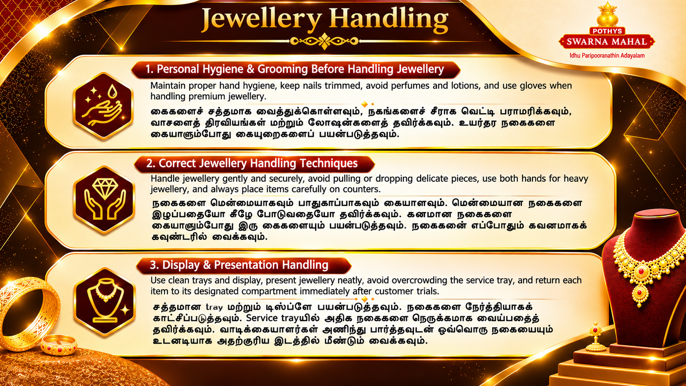

Slide 37


Slide 38
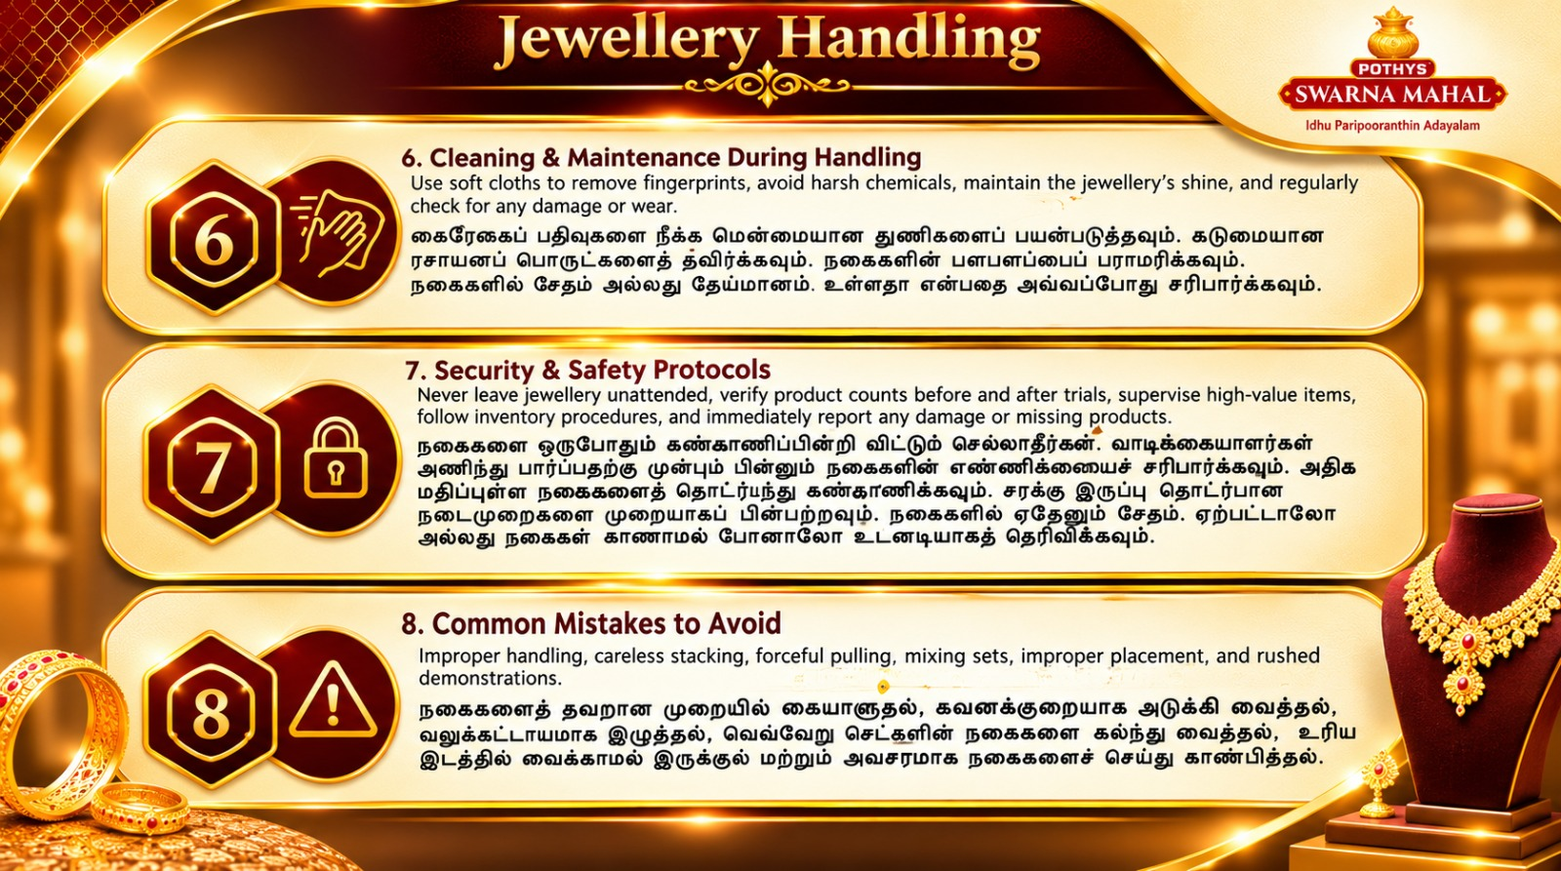

Slide 39
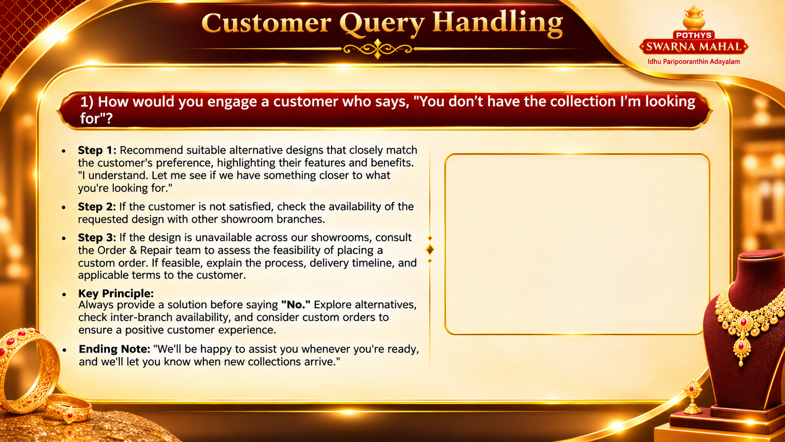
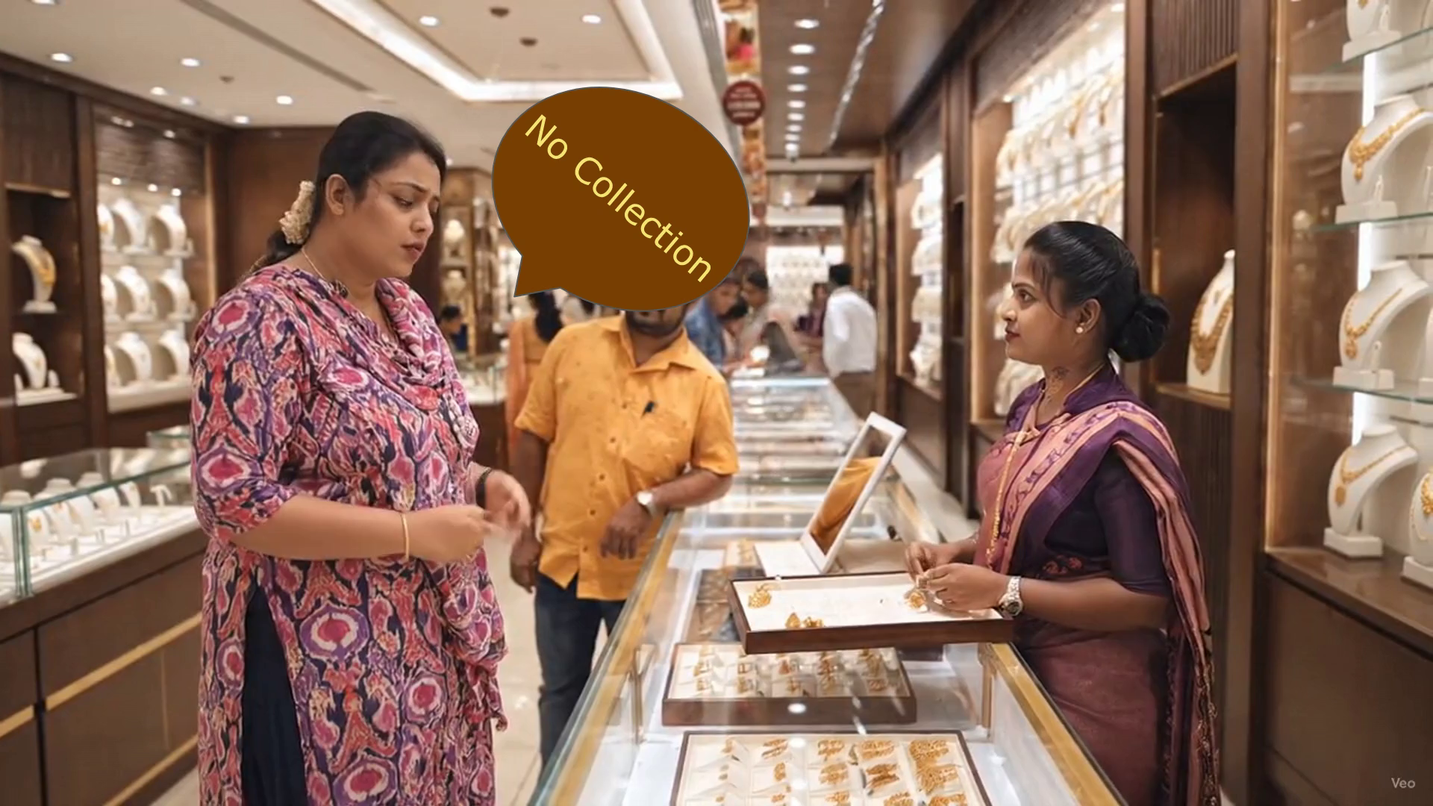


Slide 40
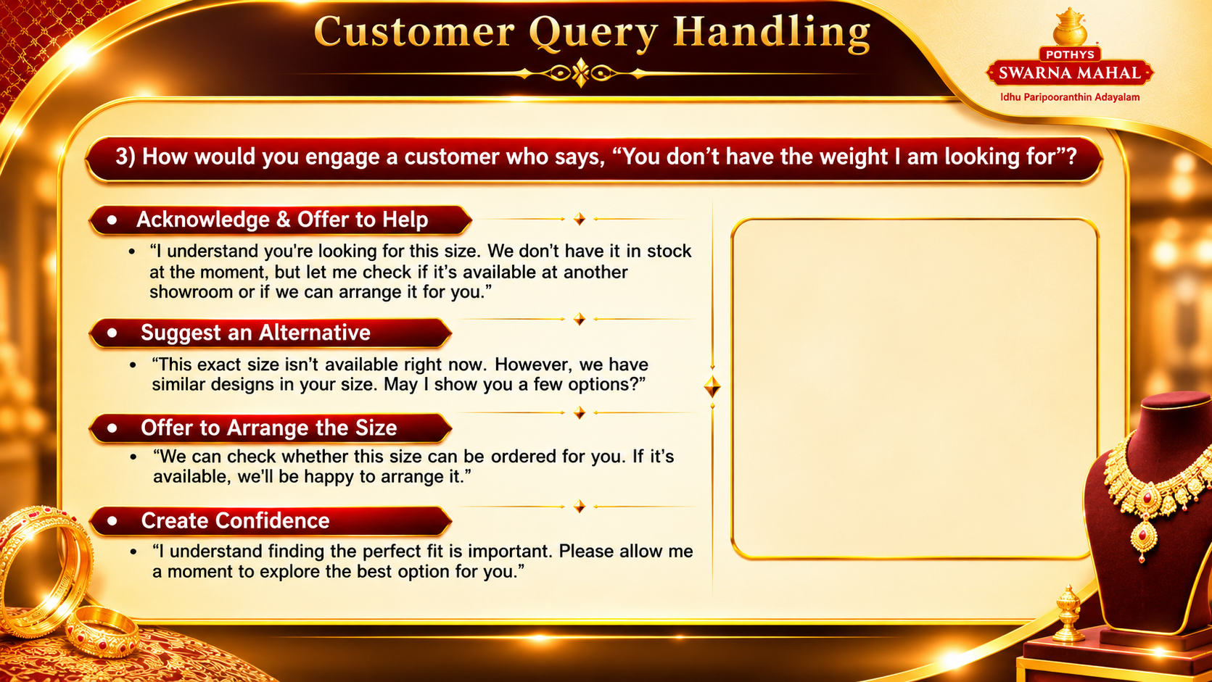
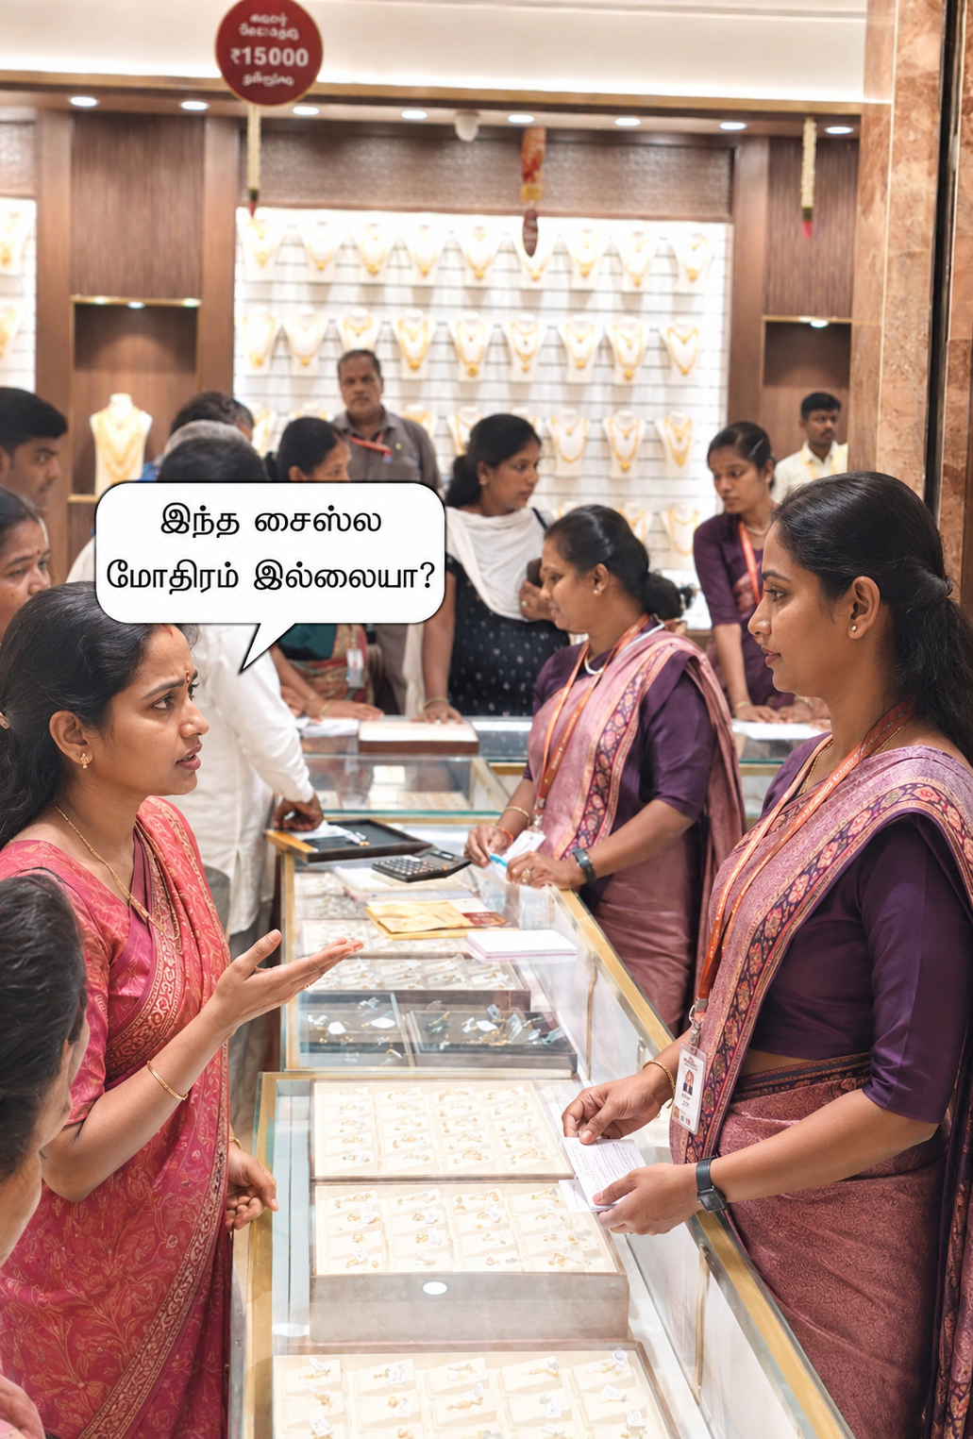

Slide 41
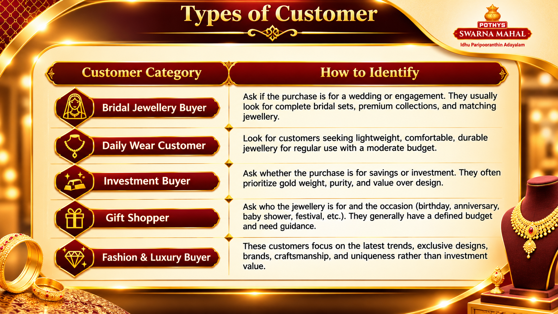

Slide 42


Notes:
42

